Slide 1
Module 7: Terrestrial Carbon Stocks
FREC 3004: Environmental Informatics

Slide 2
What is the difference between
a carbon flux and a carbon stock?
Module 6
Module 7

Slide 3

A bathtub as an example of a system

Slide 4
What is the stock?
The elements of the system that you can see, feel, count, or measure at any given time.
Units include area or volume
Stock = mass of water / m3

Slide 5
What are the fluxes?
Process that changes stocks over time
A rate or flux
Units must include time
Flow in is a flux
(mass water/m2/sec)
Drainage is a flux
(mass water/m2/sec)

Slide 6
What is the difference between
a carbon flux and a carbon stock
Carbon stock
Carbon flux
Carbon flux

Slide 7
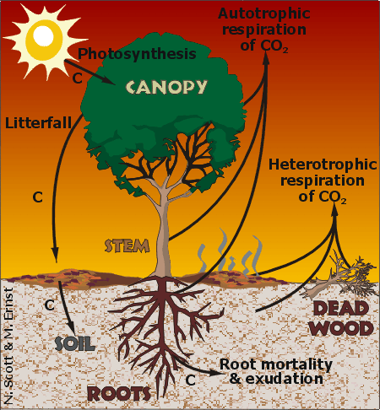
Stocks
Canopy
Stem
Roots
Soil
Dead Wood
Vegetation
Carbon stocks
Fluxes
Photosynthesis
Litterfall
Root mortality & exudation
Autotrophic respiration
Heterotrophic respiration

Slide 8
What is the difference between
a carbon flux and a carbon stock
Carbon stock
vegetation
soils
GPP
RE
Carbon flux
Carbon flux

Slide 9
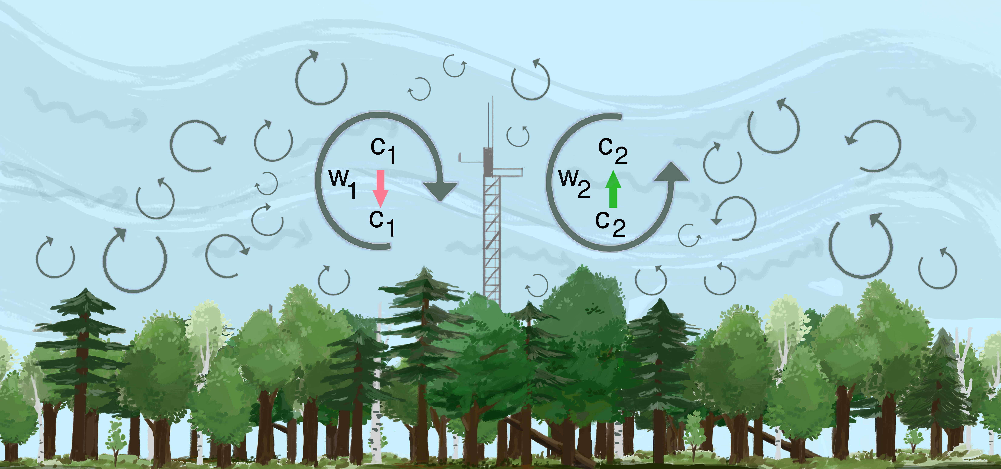
Eddy-covariance = carbon fluxes
Artist: Catherine McGuigan, VCU BS ‘18
Notes:
For a primer of eddy-covariance see box 1 of: https://nph.onlinelibrary.wiley.com/doi/10.1111/nph.15227 and https://en.wikipedia.org/wiki/Eddy_covariance

Slide 10
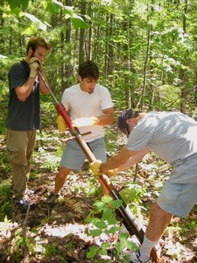
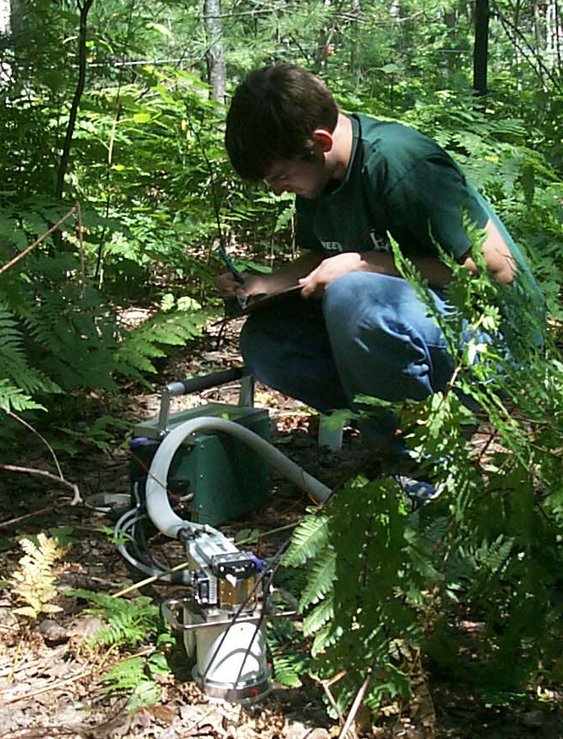
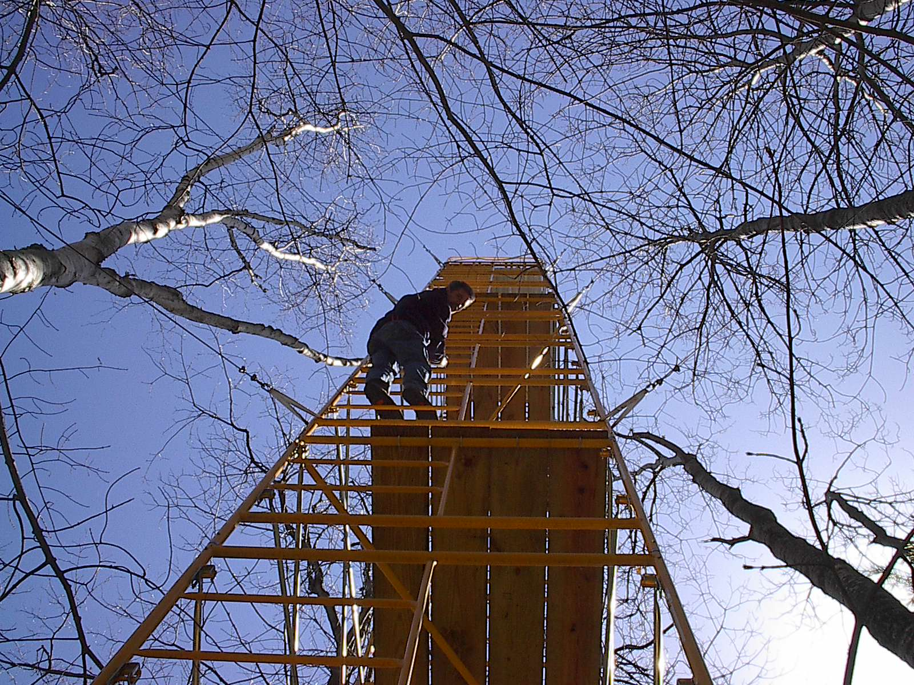
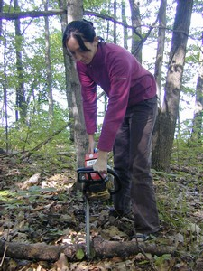
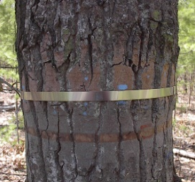
Inventory method = carbon stocks
Net ecosystem production = Net primary production – Heterotrophic respiration
CO₂
Live wood
Roots
Dead wood
Leaves
Heterotrophic
respiration
Images: C. Gough and P. Curtis

Slide 11
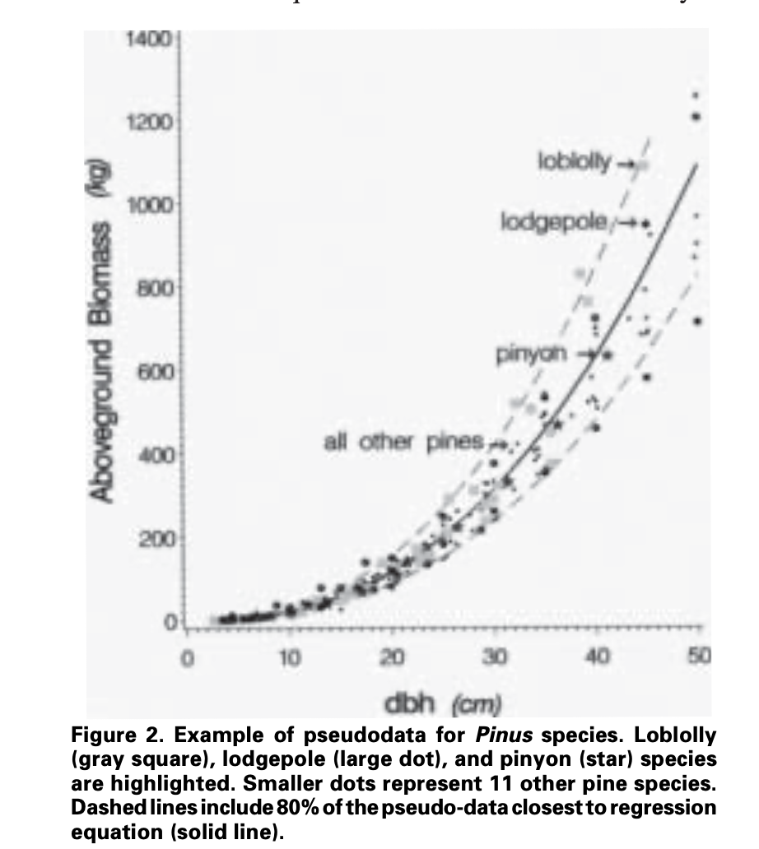
Measurements of trees in a plot
Equations
were
made
by cutting
and
weighing trees
Convert dbh to
biomass using
equations
Measure
Diameter
(called dbh;
diameter at
breast height)
Measure
diameter
Sum mass of trees in the
plot and divide
by the area of the plot
Plot (size = 500 m²)
Carbon stocks in vegetation
(kg C/m²)

Slide 13
Why are carbon stocks important?

Slide 14
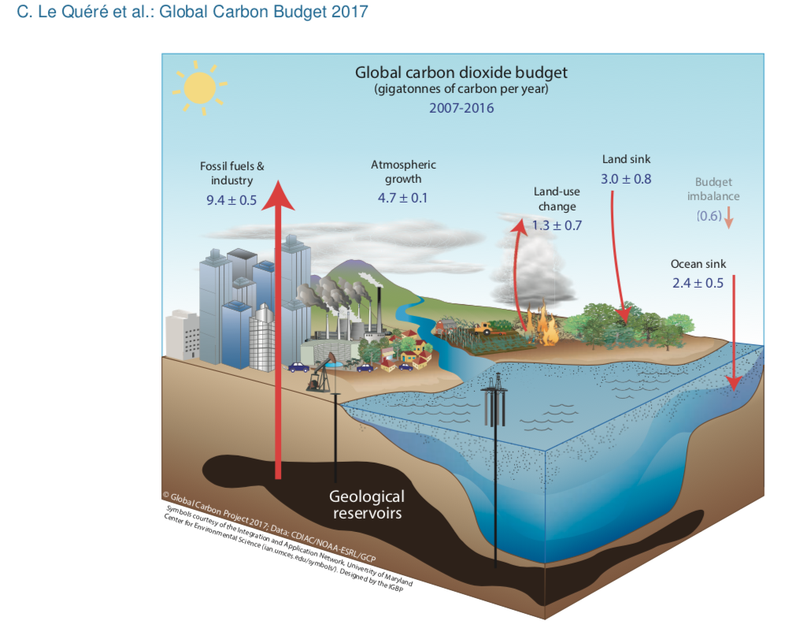

Slide 15
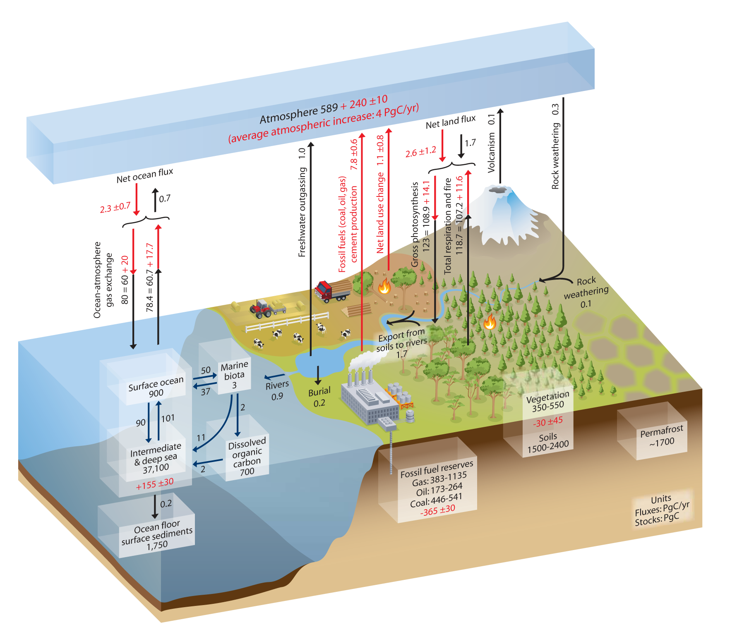

Slide 16
Which is better for reducing CO2 in the atmosphere and
helping mitigate climate change?
Young forest
High carbon flux (NEP is large and positive)
Low carbon stock
Old forest
Lower carbon flux (NEP is positive but small)
High carbon stock

Slide 17

National Ecological Observatory Network
https://youtu.be/38JQXPubMoA
https://youtu.be/zYr9vII-iu4
https://youtu.be/9IbbdQC1N3A

